Slide 1

Artificial Neural Networks - Project
W12AIR-SM0721P
Wine quality classification using Artificial Neural Network
Presentation1
Autors in group:
Paweł Ozga
Pranav Pramod

Slide 2
Milestone
Presentation 1 (25.03.2025) Topic - Wine quality classification using ANN.
(8.04.2025/6.05.2025) Prepare code to next presentation.
Presentation 2 (20.05.2025) Multilayer prescription, function, back propagation etc.
(20.05.2-25/3.06.2025) Preprocessing set Test/Train/Validation.
Presentation 3 (17.06.2025) Project - Solution.

Slide 3
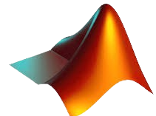

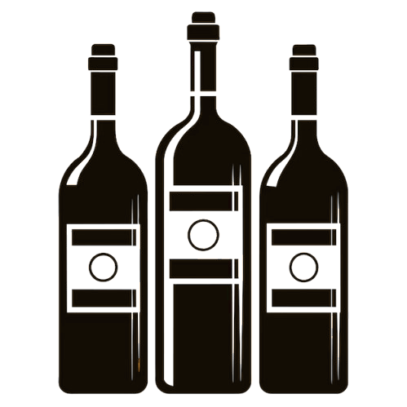
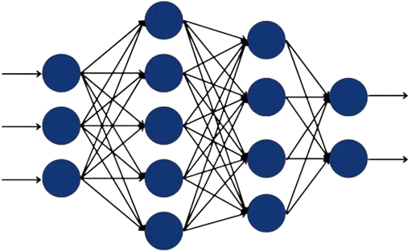
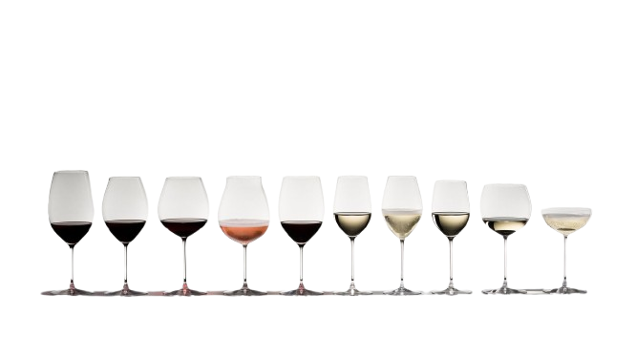
MATLAB Toolbox: Statistics and Machine Learning & Deep Learning
EXCEL Dataset : We train our model using DATASET (with numerous variables) containing various wine sample with features.
INPUT
(features)
OUTPUT
(classes)
Dateset : by Andrewmchen and Mateiz from GitHub
link: https://github.com/mlflow/mlflow-example/blob/master/wine-quality.csv

Slide 4
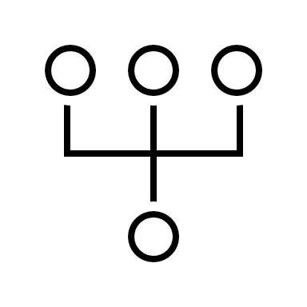


Division of responsibilities
Paweł Ozga
Pranav
Research about MLP network
Effect of Bias in Neural Network
Back propagation
Levenberg – Marquardt algorithm
Coding: both
Model Development & training
Documentation & presentation
Dataset & Handling
Coding: both
Model Development & training
Documentation
Preprocessing
Presentation

Slide 5

Any Questions?
Presentation1

Slide 6
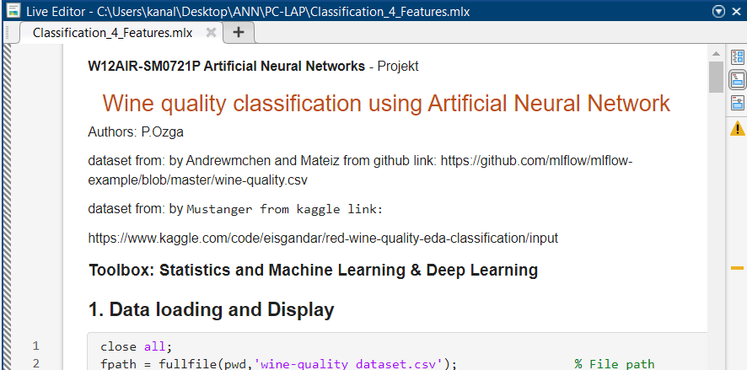
DATASET PREPARATION, BUILDING NETWORK, DISPLAYING RESULT
Presentation2
…

Slide 7
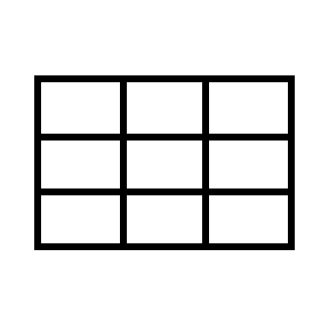


ARCHITECTURE OF CODE: MATLAB
RESULT
Prediction and Evaluation,
Acuracy,
Confusion Matrix:
BUILD & TEST
Data Splitting,
MLP network:
DATASET
Data loading and Display,
Data Verification,
Dataset Statistics Calculation,
Sample Selection,
Class Distribution,
Normalization input,
Label Encoding (One-hot Encoding)
…
…
Input: One feature for one neuron
Output: quality class (3-LOW ,9-HIGH)
1-hidden layer of linear dependencies
2-hidden layer of nonlinear dependencies

Slide 8



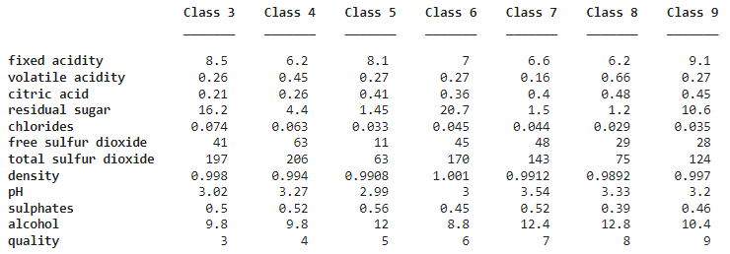
AVERAGE OF SAMPLES FOR EACH CLASS
most significant feature
less important feature
Wine score
Class 3:
Class 4:
Class 5:
Class 6:
Class 7:
Class 8:
Class 9:
fixed acidity (8.5) ↑ , Residual sugar (16.2) ↑
free sulfur dioxide (63) ↑, total sulfur dioxide (20.6) ↑, pH (3.27) ↑
alcohol (12) ↑, chlorides (0.033) ↓, density (0.9908) ↓
residual sugar (20.7) ↑ , alcohol (8.8) ↓, density (1.001) ↑
alcohol () ↑, pH (3.54) ↑, volatile acidity (0.16) ↓
sulphates (0.39) ↓, density (0.9892) ↓ , alcohol (12.8) ↑
fixed acidity (9.1) ↑, citric acid (0.45) ↑, residual sugar (10.6) ↑

Slide 9
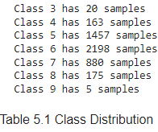
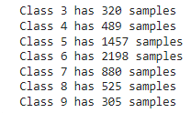



PREPARING DATASET
Raw Dataset: number of samples matters! Because in this set:
The neural network overfits the training data.
Classes 3 and 9 are ignored, and Class 6 dominates the dataset.
REMEDIES:
Oversampling:
- SMOTE creates synthetic samples of the minority class,
- Random Oversampling duplicates existing minority samples,
- Risk of overfiting,
- Balances class distribution
Undersampling:
- Removed dominant classes,
- Fastes training,
- Possible loss of important information
Manual/Define class weights
- Assign higher importance to minority classes in the loss
function
- Defining with class is important than else
- Selected samples are always in the training set
Oversampling clas 3,9
Accuracy of network 49-53%
Undersampling class 5,6
Define Class Weights
data operations were
performed using python

Slide 10
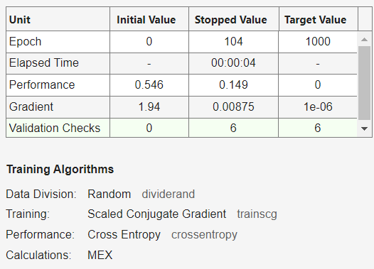
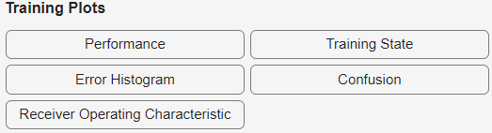
DATA SPLITTING BUILDING & TEST
MATLAB R2024b
toolbox:
Statistics and Machine
Learning & Deep Learning
FUNCTION:
%cv = cvpartition(Y_categorical, 'KFold', 5, 'Stratify', true);
cv = cvpartition(Y_cat,'Holdout',0.2);
X_train = X(training(cv),:);
Y_train = Y_encoded(training(cv),:);
X_test = X(test(cv), :);
Y_test =Y_encoded(test(cv), :);
net = patternnet([90, 40]);
net.trainFcn = 'trainscg’;
net.layers{end}.transferFcn = 'softmax’;
net.performFcn = 'crossentropy’;
net.trainParam.showWindow = false;
[net, tr] = train(net, X_train',Y_train');
1. SPLITING
2. ARCHITECTURE
3. TRAINING PROCESS
4. TRAINING PLOTS
CONFUSION MATRIX

Slide 11
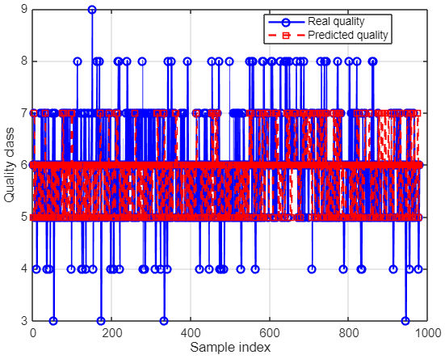
PLOT & GRAPH RESULT
Alcohol, Volatile acidity, Sulphates = set A4
A4 + Citric acid, Density, pH, Total sulfur dioxide, …
… Chlorides, Residual sugar, Fixed acidity, Citric acid = set B11

